Slide 1
The Khopesh Time-portal
Written and Illustrated by
Ossian Harris Tait

Slide 2
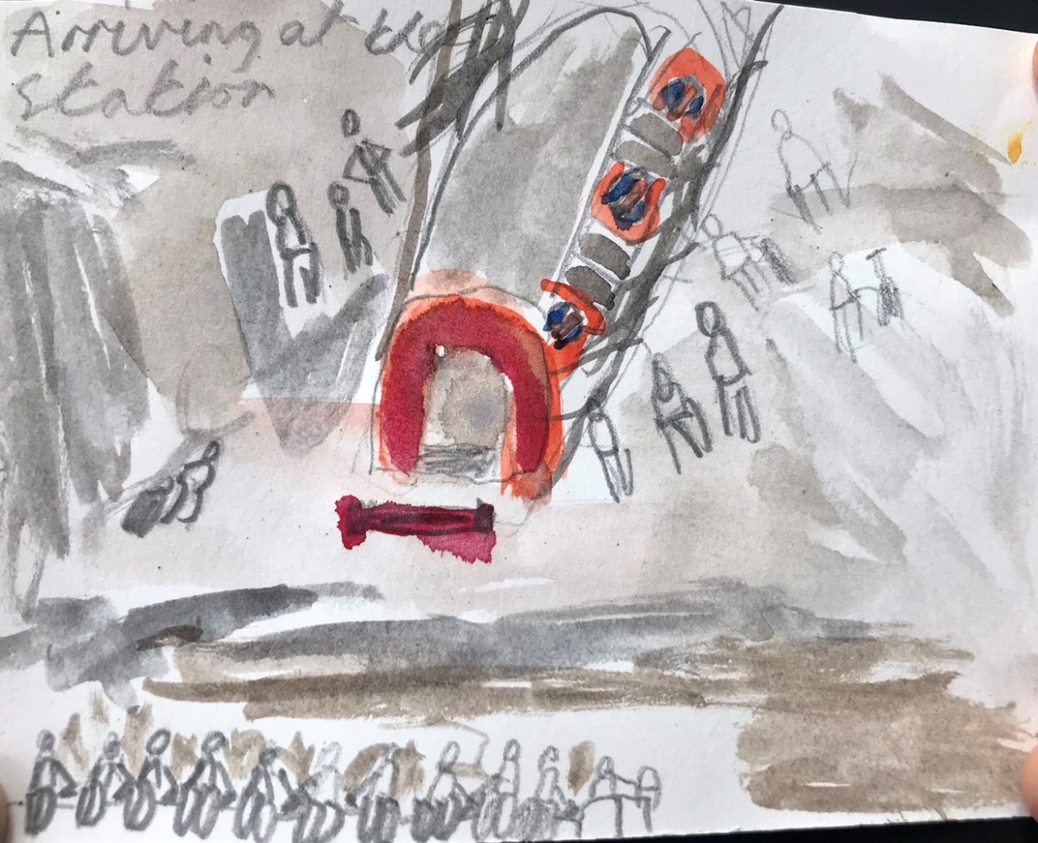
Every Summer, Year Five students travelled to the familiar face of the British Museum. They had been so many times before, it was becoming part of their annual time table. As they strolled towards the entrance, Alba slouched against the wall and ignored the beautiful carvings of the desolate, grey Victorian architecture. Then, they were greeted by the same guide who took them through the usual same rules. Once again, Alba was as bored as she had been on this treacherous trip for the past five years.

Slide 3
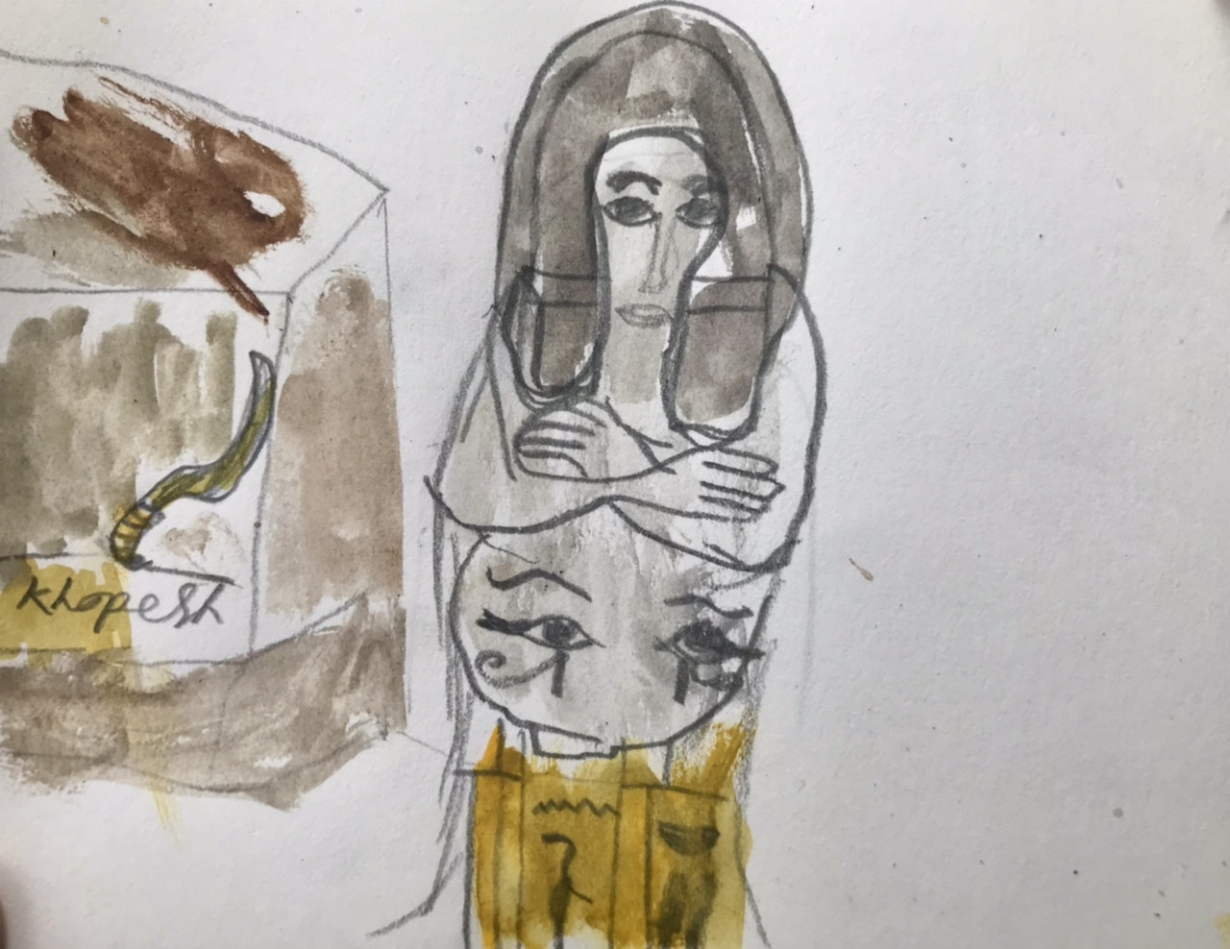
During the tour, Alba had, fallen asleep on her teacher’s arm and squirted juice on the museum’s floor. The guide told them once again about how the Enlightenment room had come to be there. As they meandered away from the Waddesdon Bequest, Alba actually looked at the exhibits! It was the Ancient Egyptian display. Colossal sculptures majestically towered over her. However, a particular object in a glass cabinet captured her attention. The label on it said it was a ‘Khopesh’, a circular sword from Ancient Egyptian times, used in battle. Alba was entranced by the khopesh: its sparkling hand-carved grip enlaced with gold;the jagged, arched, silvery blade and a deadly sharp point, expanding towards her.

Slide 4
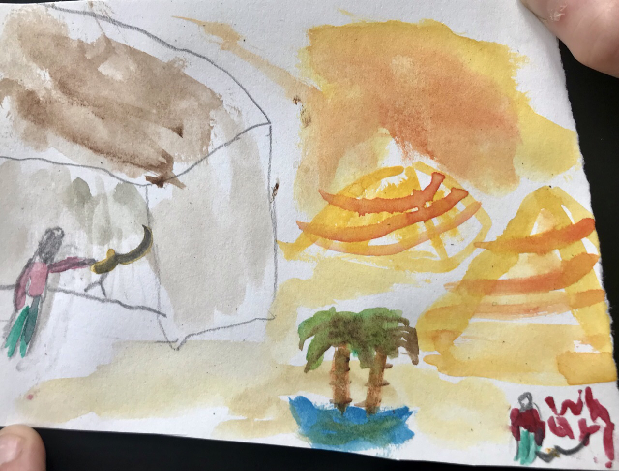
As her class drifted away from the Egyptian display, Alba apprehensively, lingered around the vitrine that held the khopesh. Its lining was so enticing it seemed to control her mind! Suddenly, her arm was up in the air reaching towards the glass! She then, extended her hand inside the glass and grasped it…she actually grasped it!
A sharp, caustic pain met her touch. The next thing she knew she was in the middle of a desert. How come touching the khopesh led to this? It made no sense whatsoever. However, when she had the time to look around, she fell to the ground in shock, as she was in Egypt!!! The great River Nile seeped past the banks; the palm tree stick-like trunks with glistening leaves, bathed in the sun; the ploughed fields crispened and yellowed with beams of light settling on the ancient terrain.

Slide 5
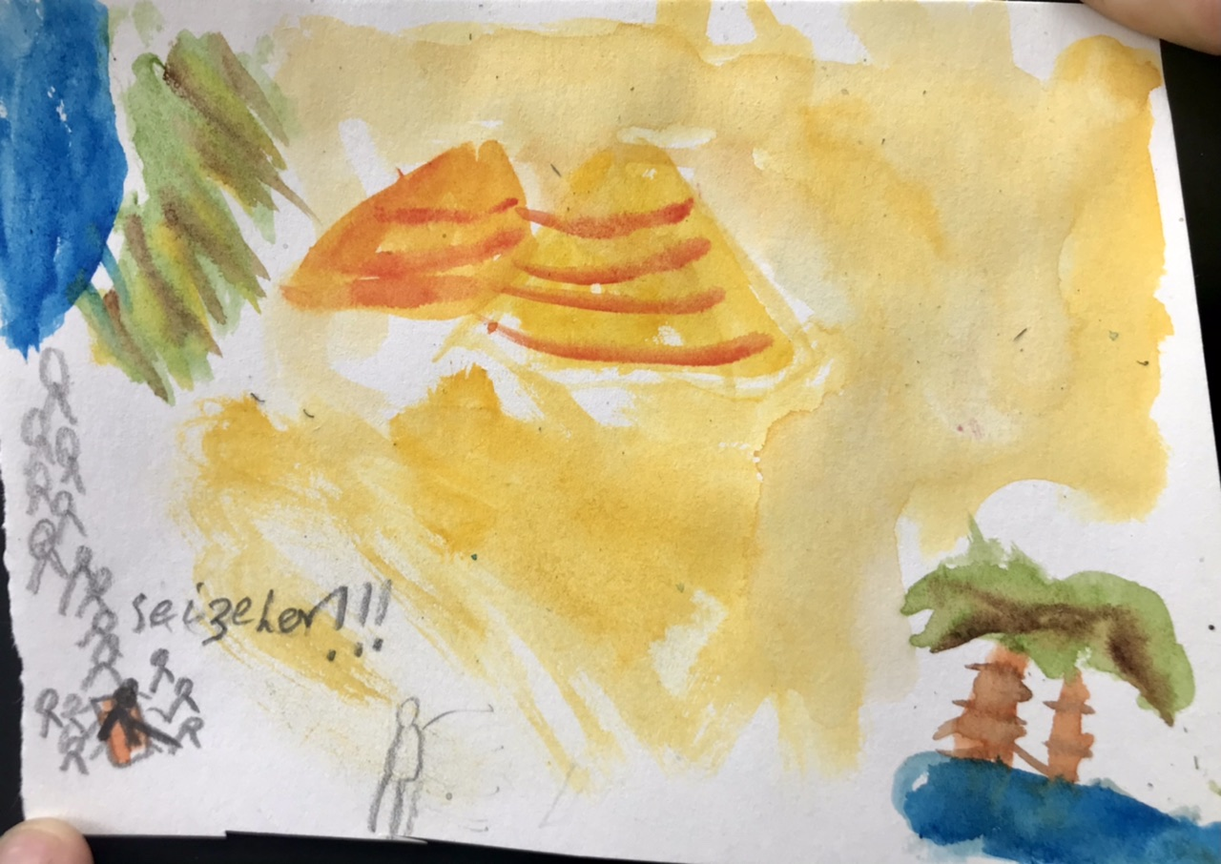
Suddenly, a procession rose from the river and she once again fell to the ground in shock. As it drew closer, Alba saw a group of men dressed in animal masks, holding swords not unlike the one she held in the museum. The sound of the imminent and pounding drums, controlled the rhythm of her steps. The gritty grinds of sand flowed around her as though they were being carried by waves. On top of a stand, carried by six men dressed as gods, was a magnificent throne fit for a queen. A beautiful lion head, attached to the throne, towered over a dazzling woman. She was wearing a golden necklace, incredibly thinly threaded, divine beads that pierced her jewels with their boldness and cobalt blue that covered her eyelids in rich tones. Unlike the others she not wearing a mask. However, as nice as she may have looked, she was staring and pointing directly at Alba!

Slide 6
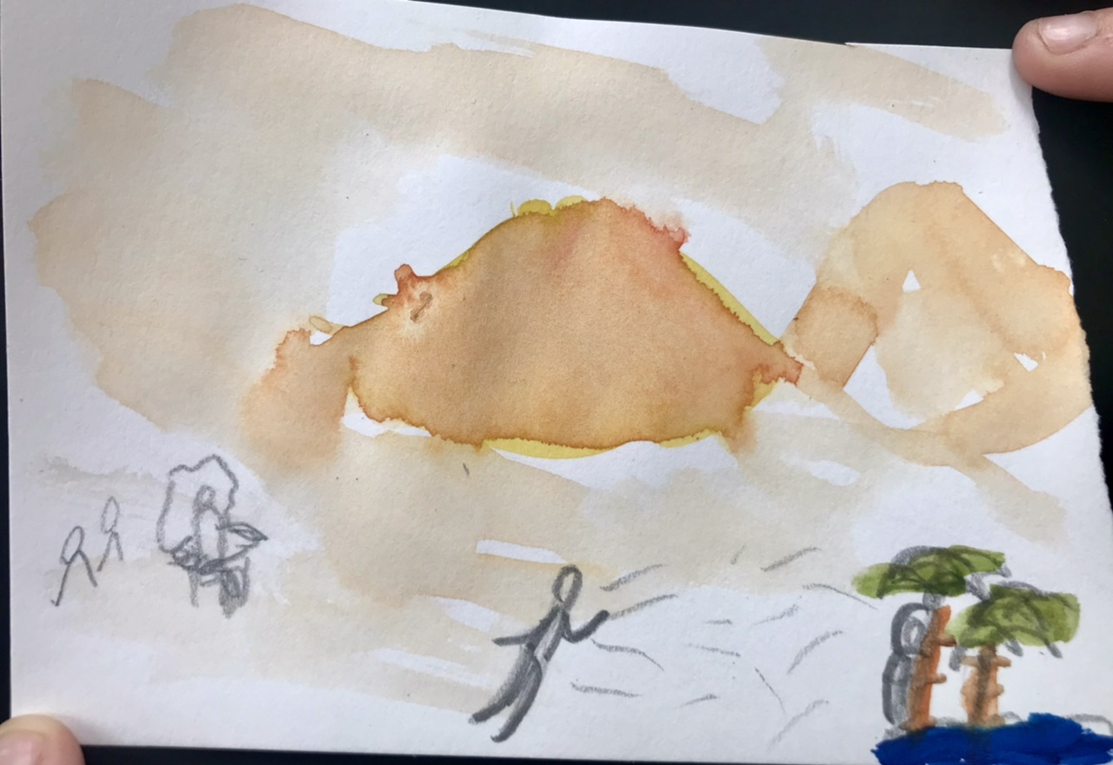
In a fearful stride, Alba started to sprint away from the newly appointed queen’s guards. She needed a place to hide, but where? She had run away from all the pyramids. This was a disaster.
However, in a few seconds time it came to her. She could hide in the palm trees! It was the last place the guards would expect. Fortuitously, there was a pile of leaves and branches for Alba to cover herself up with in the tree. When she had a chance to relax, she noticed the beautiful dusty triangles of the pyramids, in the burning, golden landscape. As she looked down to get into position, she almost fell out of the tree! Standing below her was one of the guards and he was starting to climb the trunk.

Slide 7
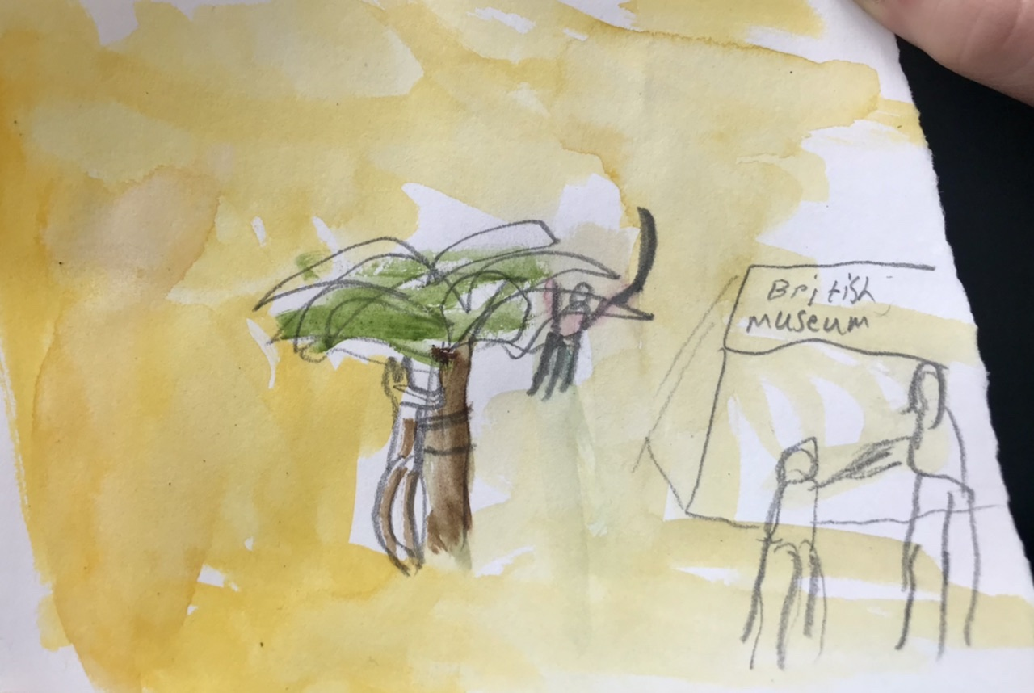
Distressed, Alba scanned the Egyptian plains for anything that could help her and then…she was what looked like a black stick fall out of the sky. As it fell closer into her sight, she noticed that it was the khopesh that she had held in the museum! Overjoyed, Alba reached out to grasp it and seconds later, she was back in the Viking display, only minutes after she had left. Then she saw Miss Parks striding towards and she looked angry. Be that as it may, she actually bent down, and said “Are you okay Alba? You look a bit pale.”
“I’m fine. But I went to Ancient Egypt, I really did,” Alba answered.
She chuckled softly and said, “you have quite the imagination.”

Slide 8
The End

